Slide 1



Sales Record Under Guidance of Internal Guide Dr. Dharmendra Patel by Meet Patel (17BCA061) Akshay Ramnani (17BCA094) Kartavya Vadera (17BCA114)

Slide 2
Project Profile

Slide 3
Project Name: Sales Record
Type of Application: Mobile Application
Project Description: This application is a generalized system designed for any mobile phone company. It helps to track sales of the company in a particular zone and to maintain employee details of the company. By going through the flow, application helps to take attendance of employees, assign targets, salary summary, leave management, daily work and track employee and also generate respective reports with security.
Team Size: 3
Front End: Android Studio
Back End: MySQL, XAMPP (Version 3.2.2)
Tools used: MS-Office (2019), Photoshop

Slide 4
Existing System

Slide 5
Ding Talk: Team Collaboration & Communication
Source: Google play store
Publisher: Taobao
We have studied this application and communicate with the employee of a company who is currently using the application. This application includes features like Team collaboration, Task Management, Attendance, Unified Communication, Leave approvals.
Limitations of this application is:
Company unable to assign targets to their employee using this application.
Employees unable to track their salary information using this application.

Slide 6
Manual filling attendance is very tedious task for them. Employees have to take their photo at the time of punch and have to upload it into the application and then higher authority will check the photo and approved their attendance. Company unable to add shop details using this application. It requires desktop.
There is no such option available which will help company to track their sales into particular area.
Employees unable to apply for resigning from company using application

Slide 7
Scope of System

Slide 8
It is a mobile based application designed for any mobile phone company.
This application includes following features:
Insert, update and delete any employee of a company.
Auto fill attendance, leave management, target status, salary summary, routine task, track employee, resigning request.
Generate different types of reports.

Slide 9
Use Case Diagram

Slide 10
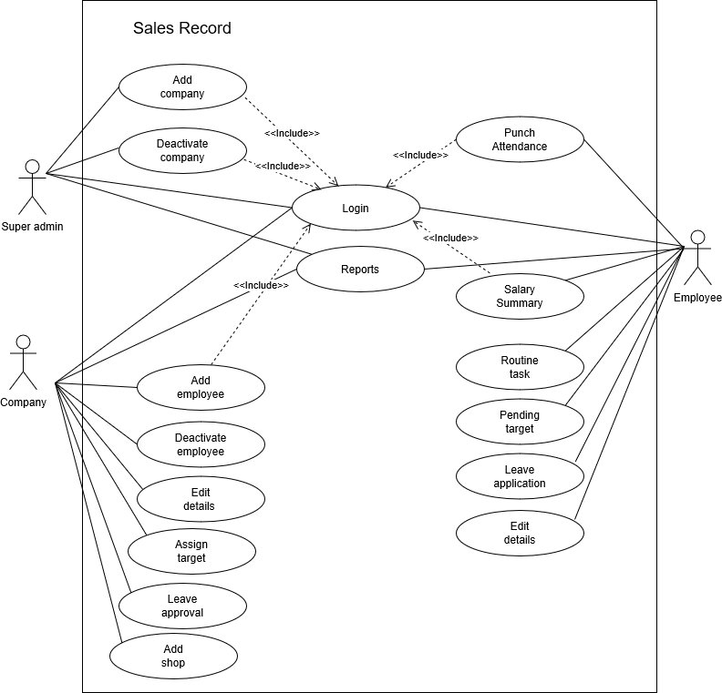

Slide 11
Activity Diagram
Actor: Super Admin

Slide 12
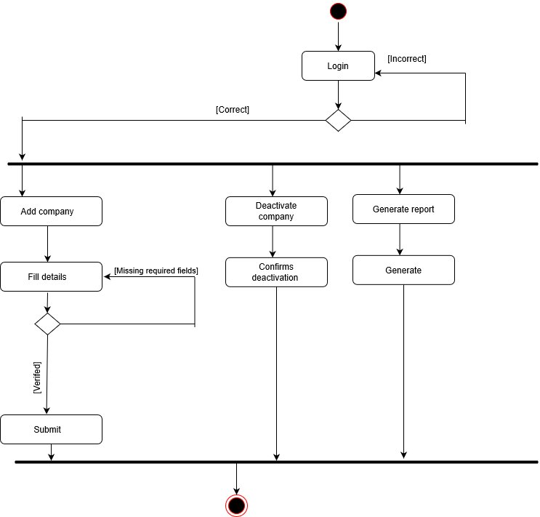

Slide 13
Activity Diagram
Actor: Company

Slide 14
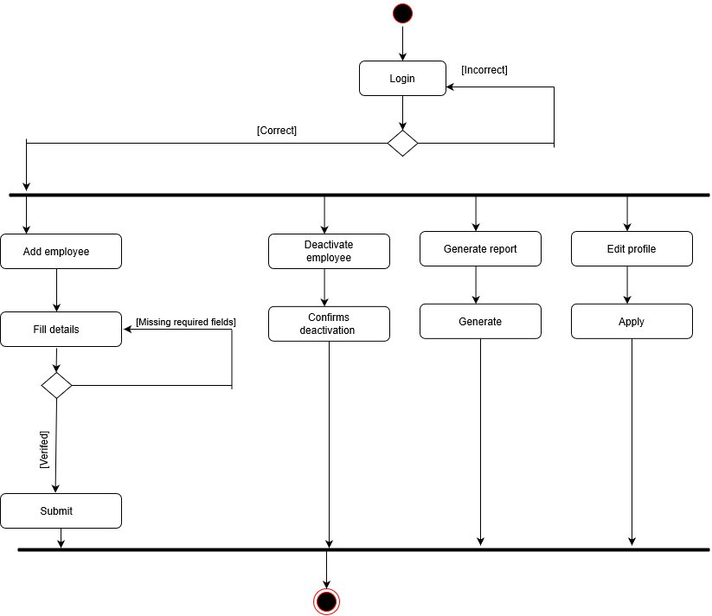

Slide 15
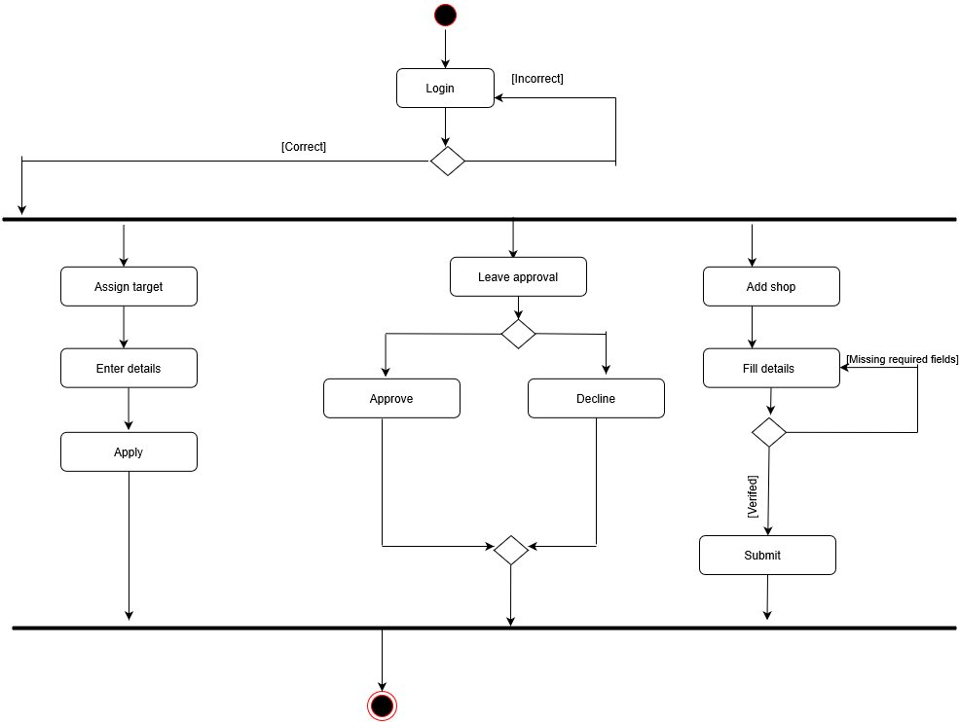

Slide 16
Activity Diagram
Actor: Employee

Slide 17
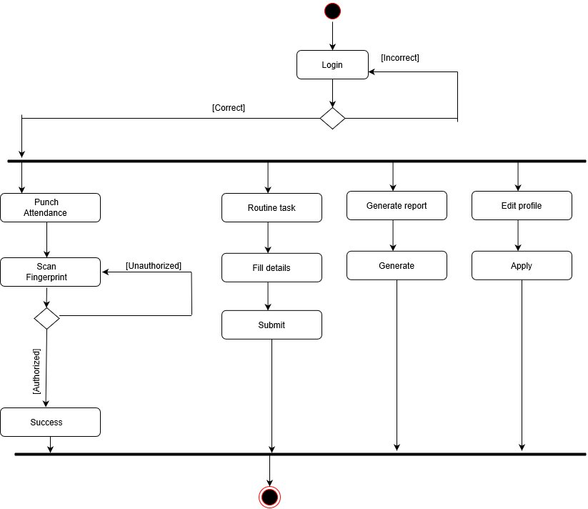

Slide 18
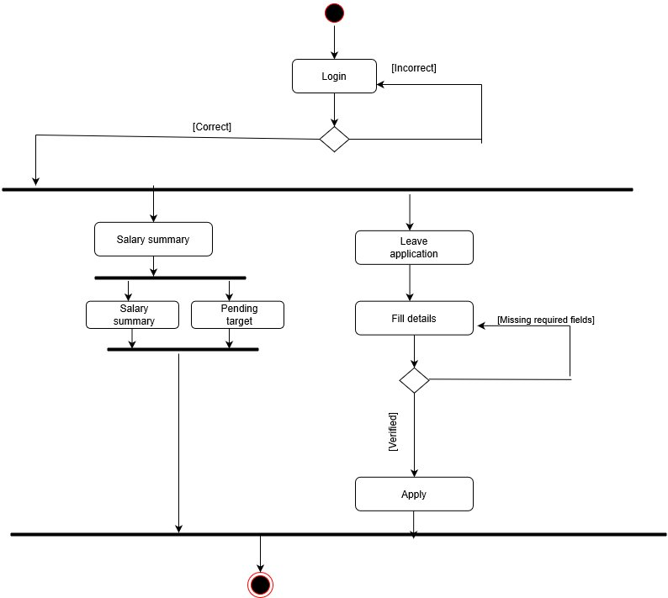

Slide 19
Screen Design

Slide 20
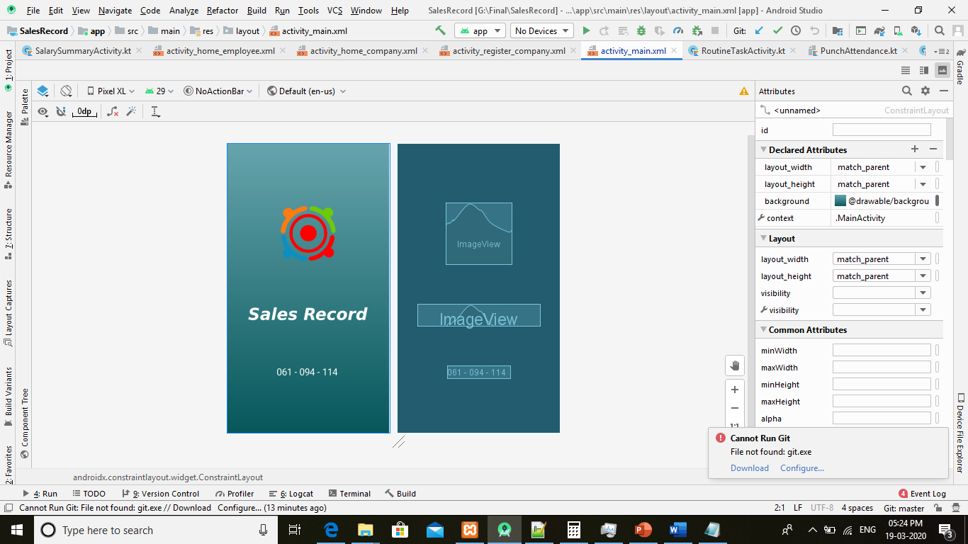
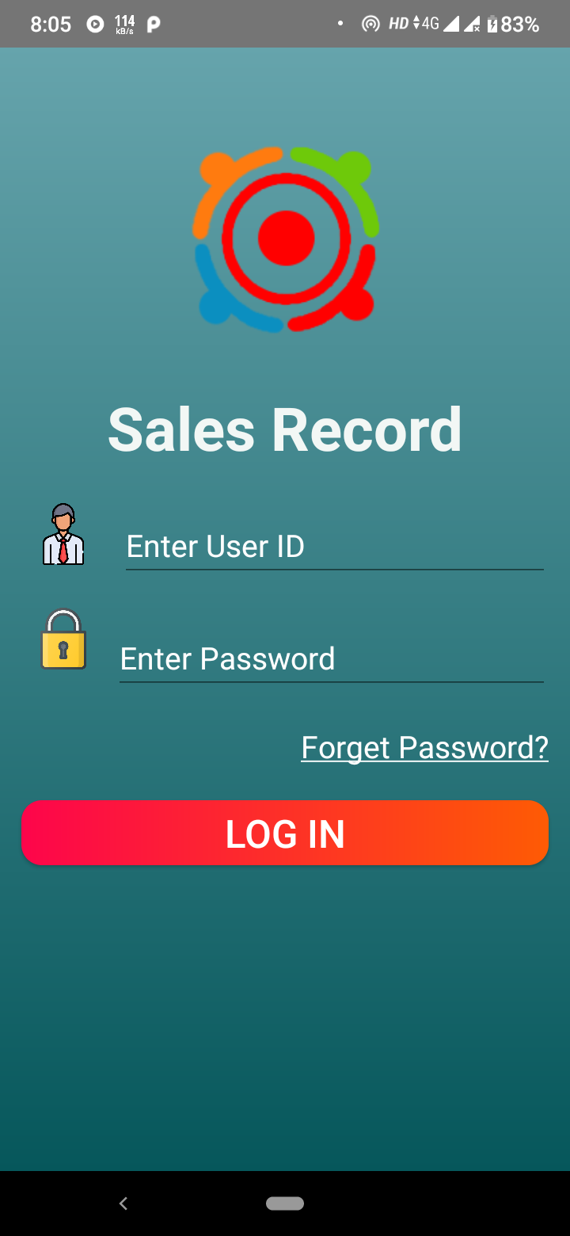
Slash Screen
Login

Slide 21
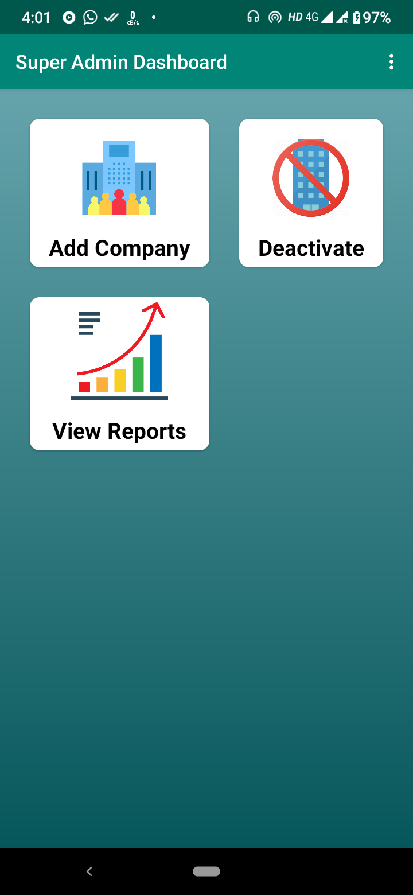
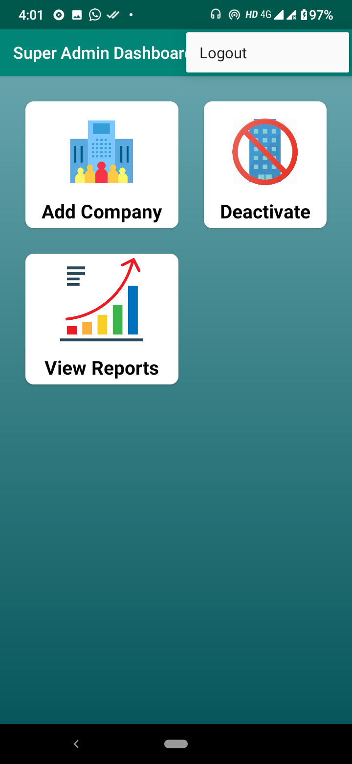
Super Admin Dashboard

Slide 22
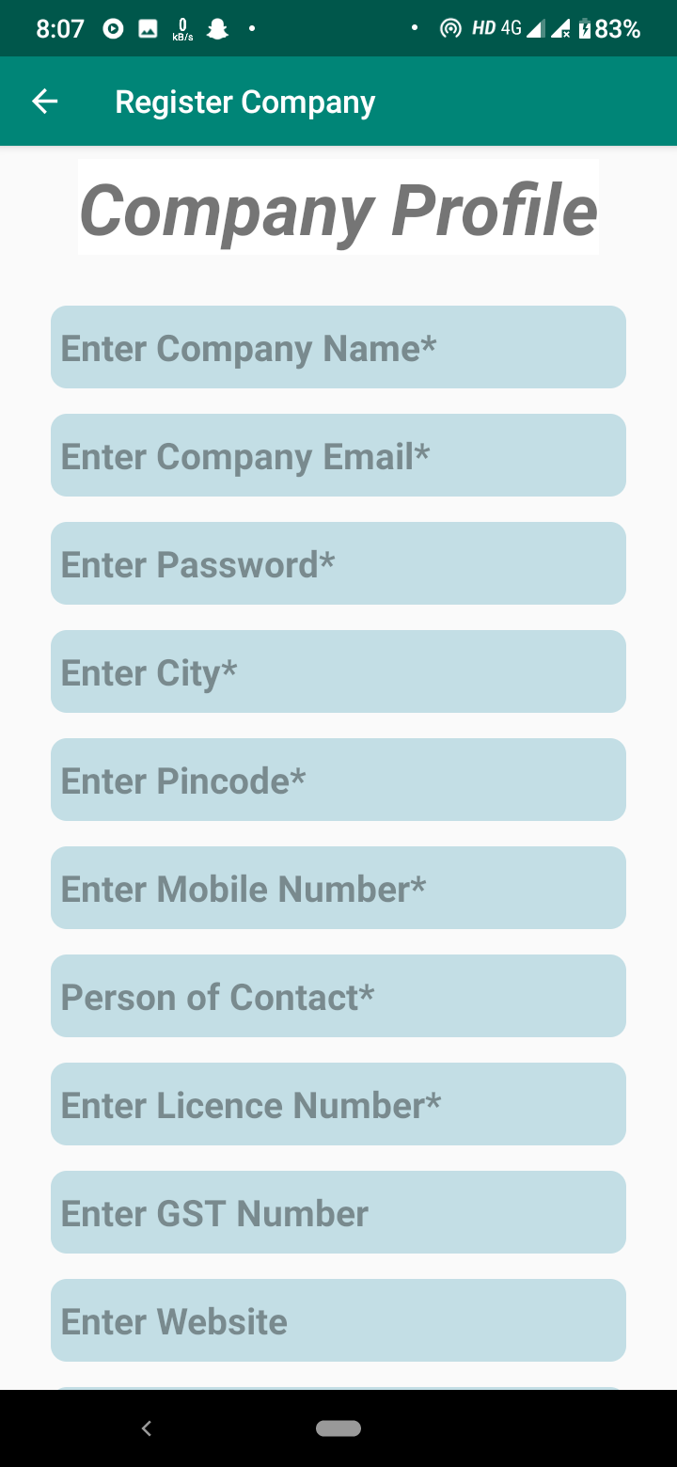
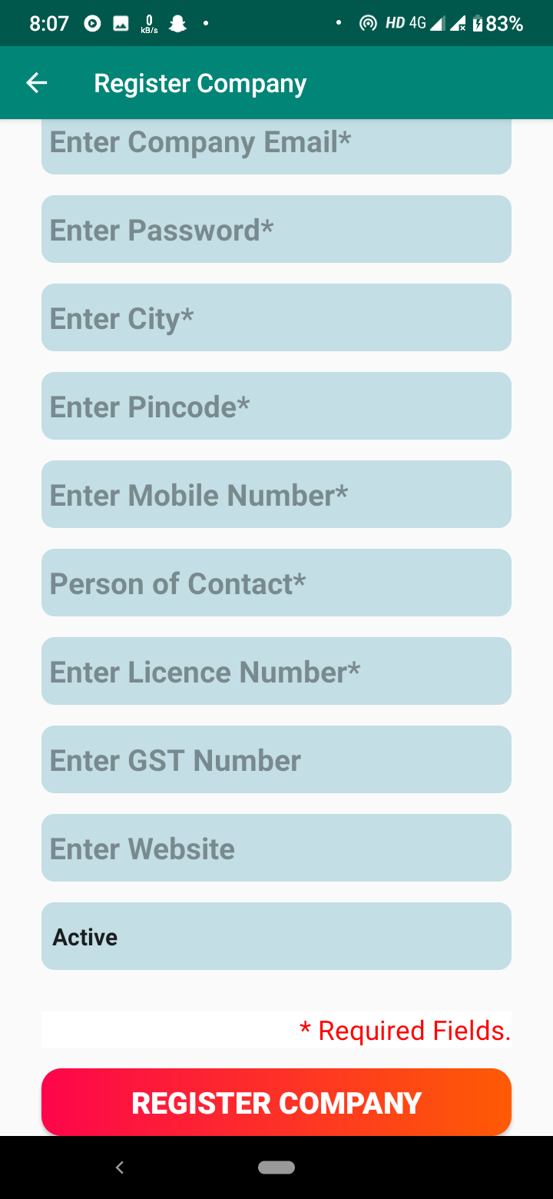
Register Company

Slide 23
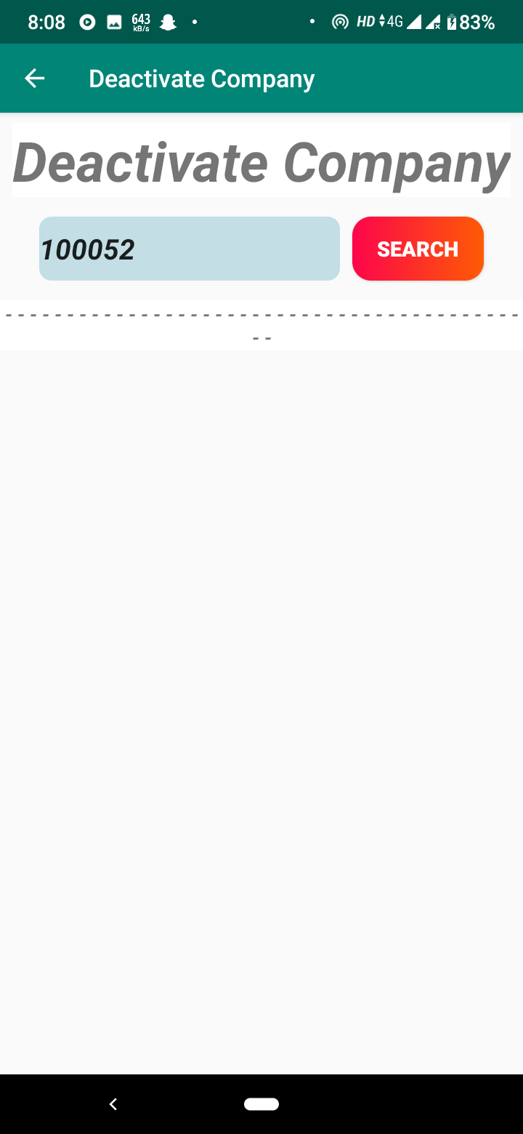
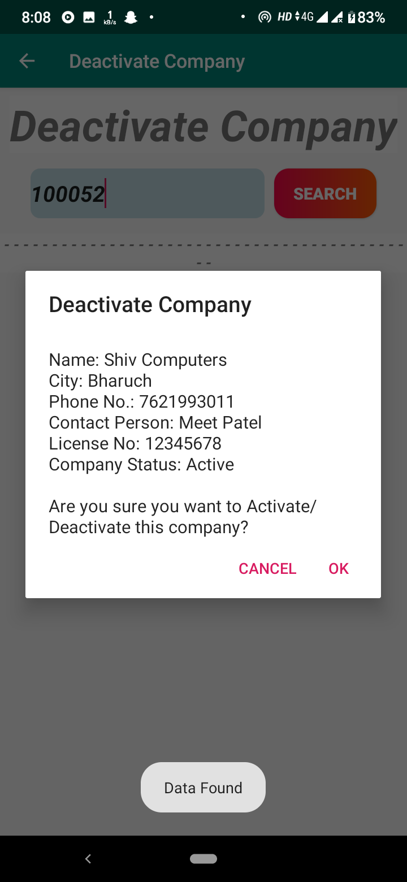
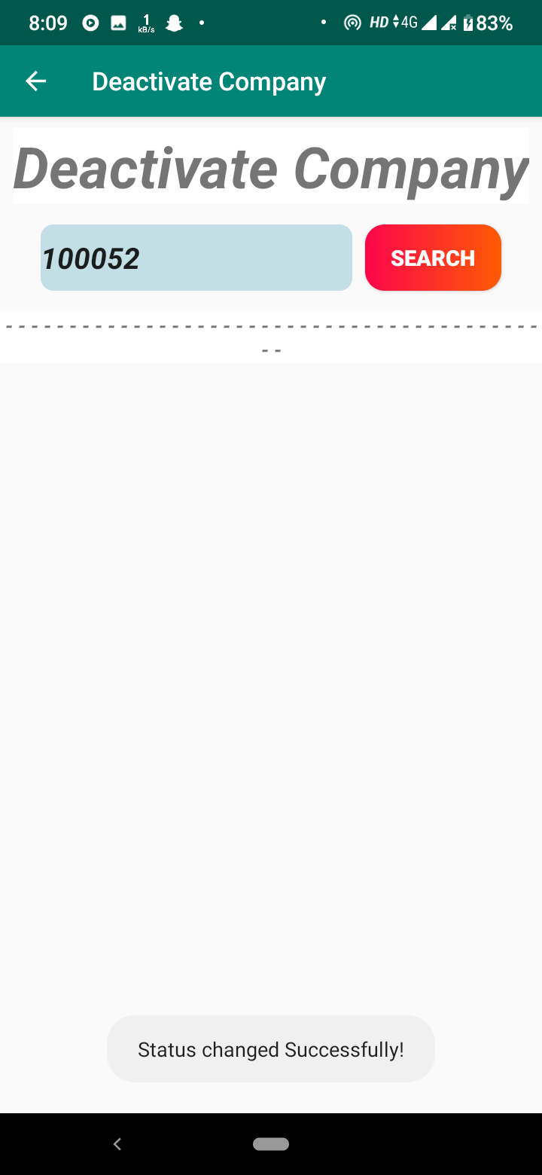
Deactivate Company

Slide 24
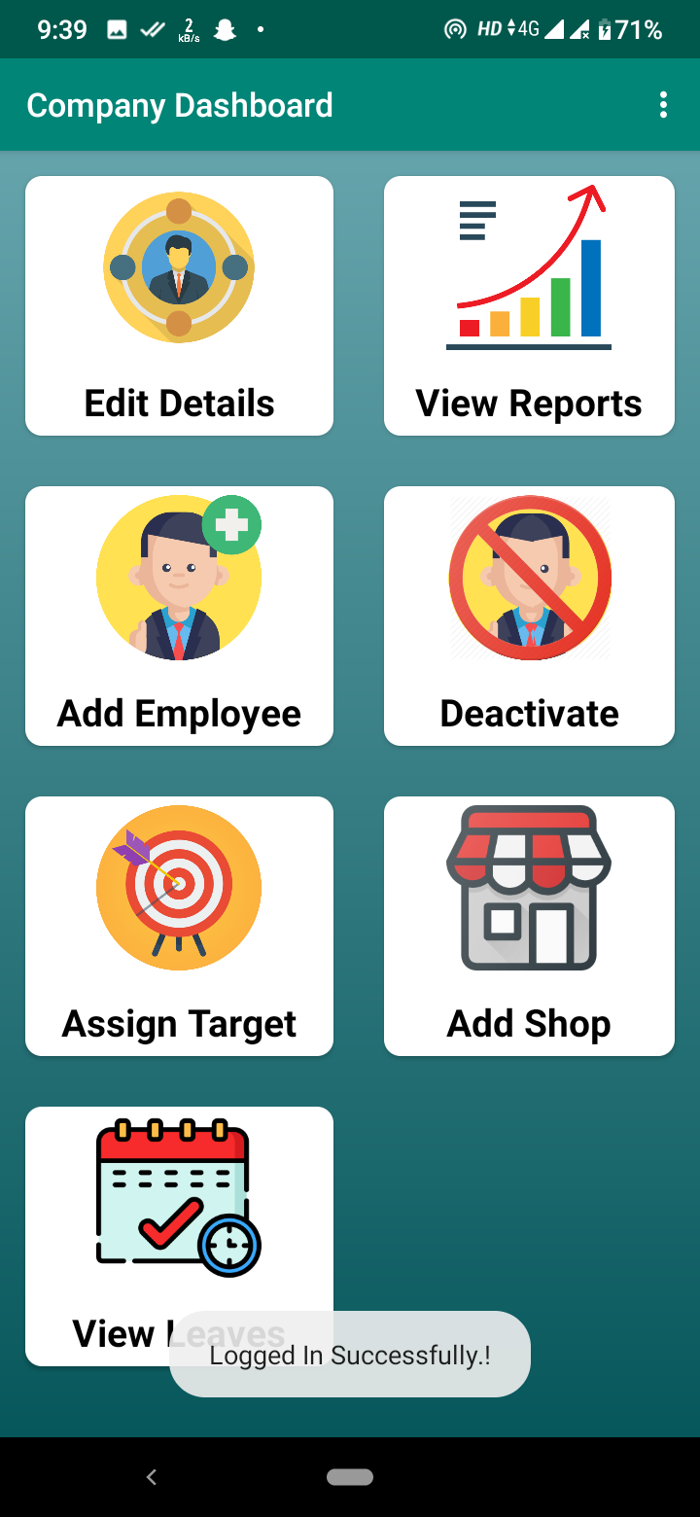
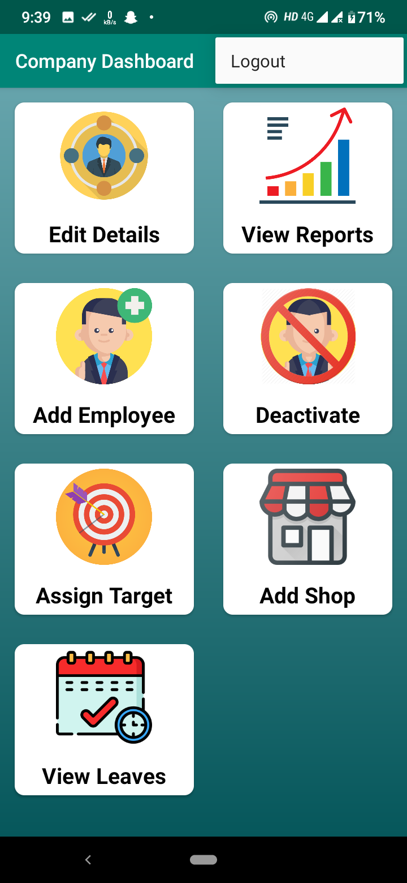
Company Dashboard

Slide 25
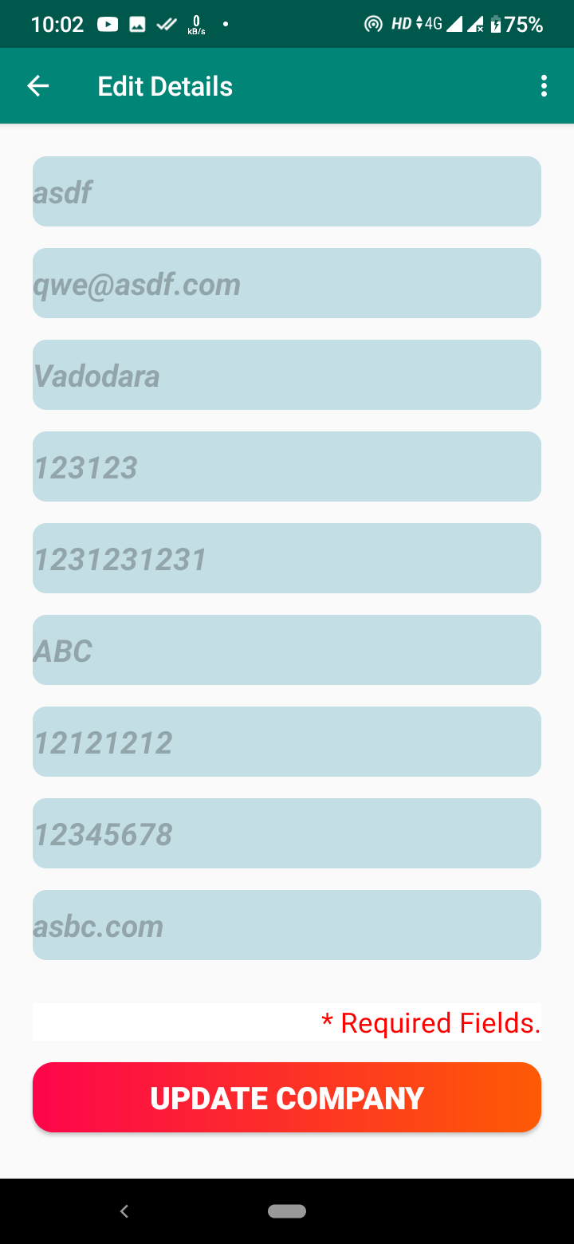
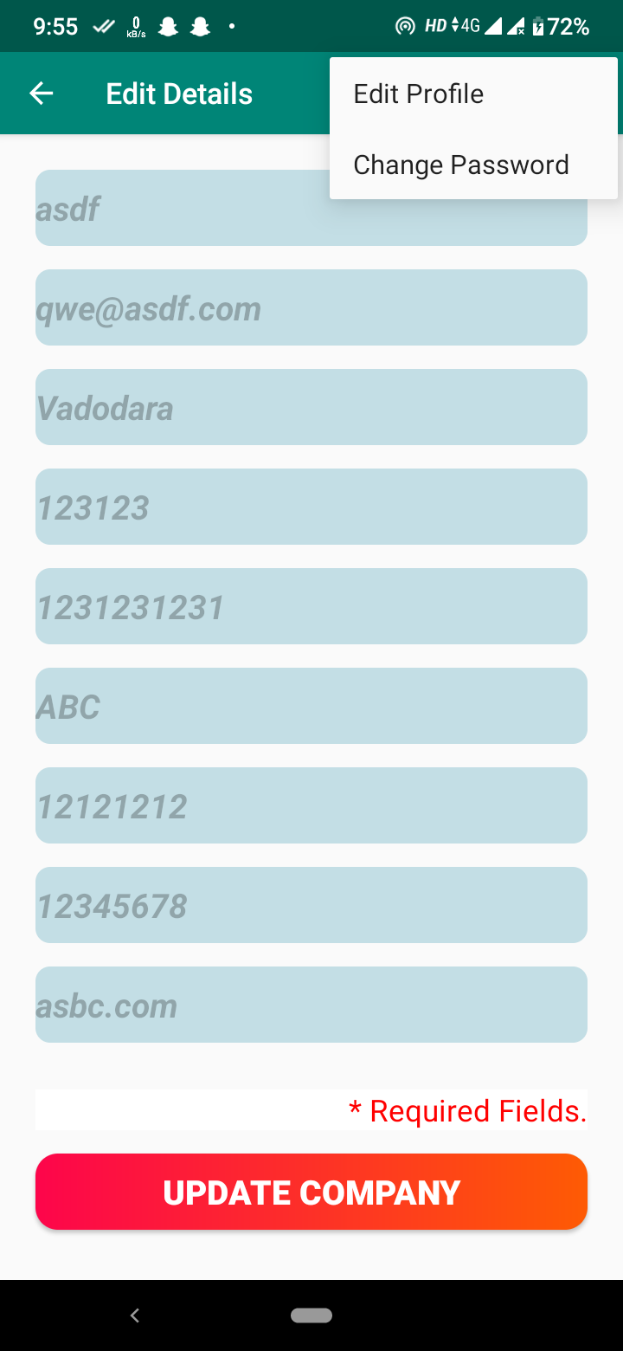
Edit Details

Slide 26
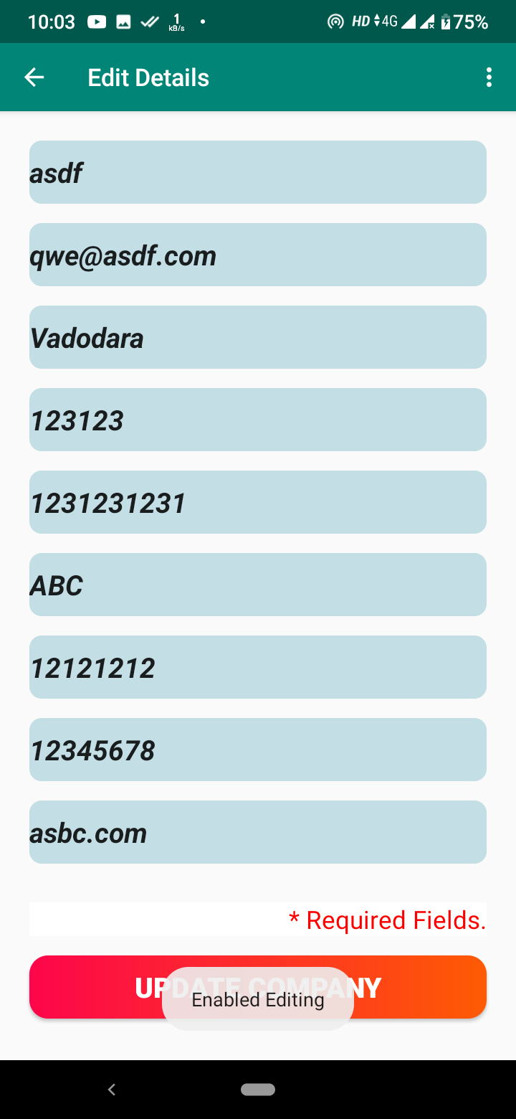
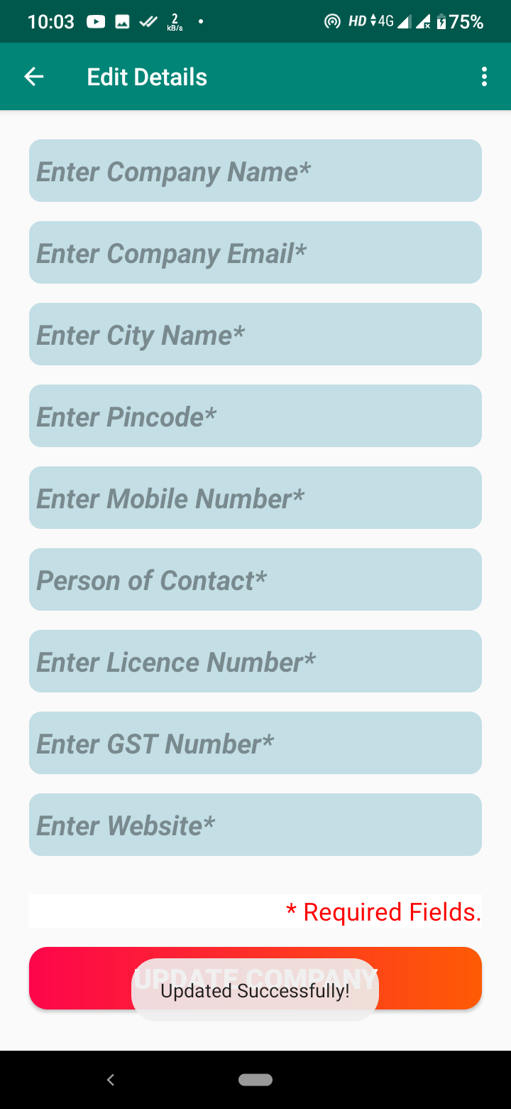
Edit Details

Slide 27
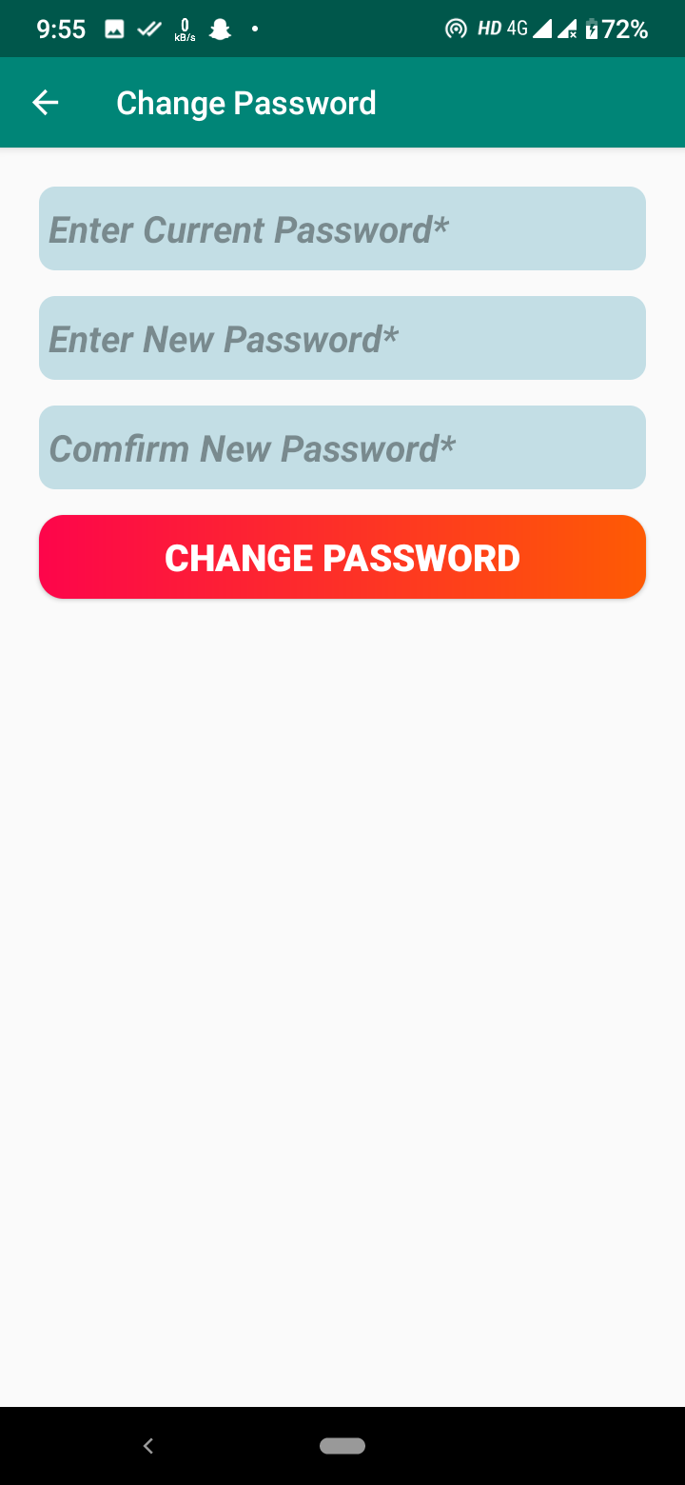
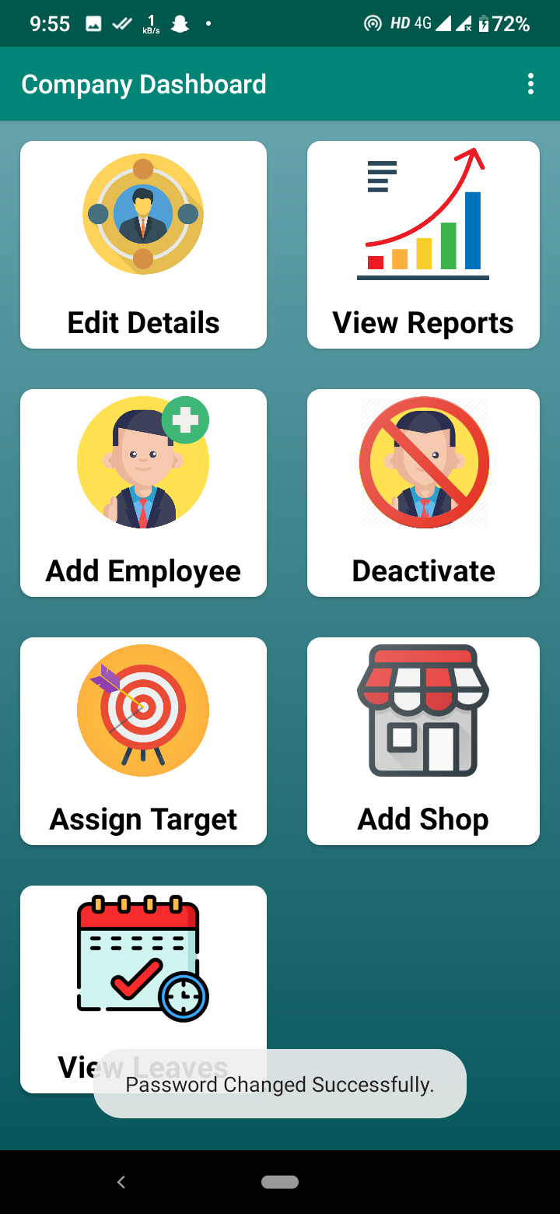
Change Password

Slide 28
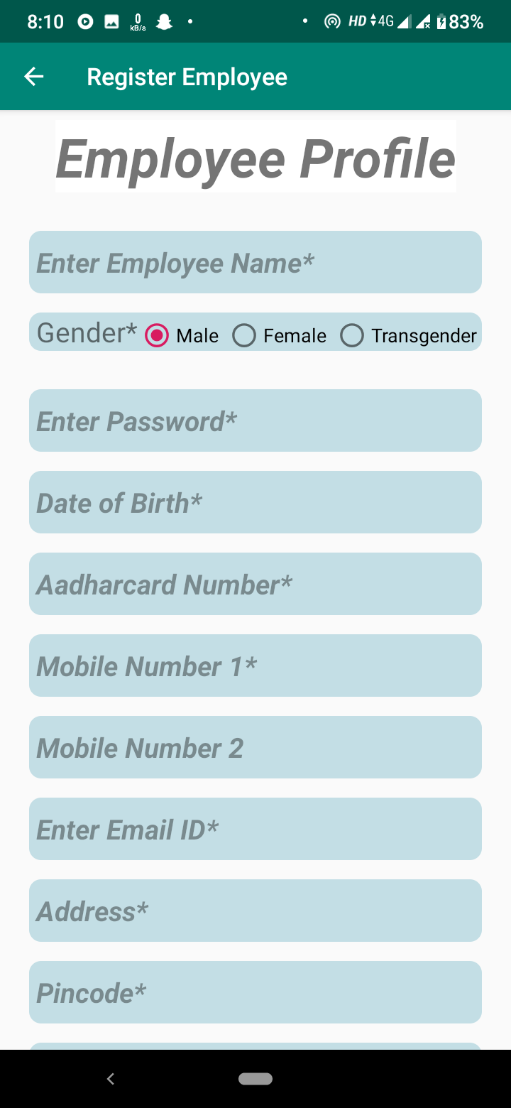
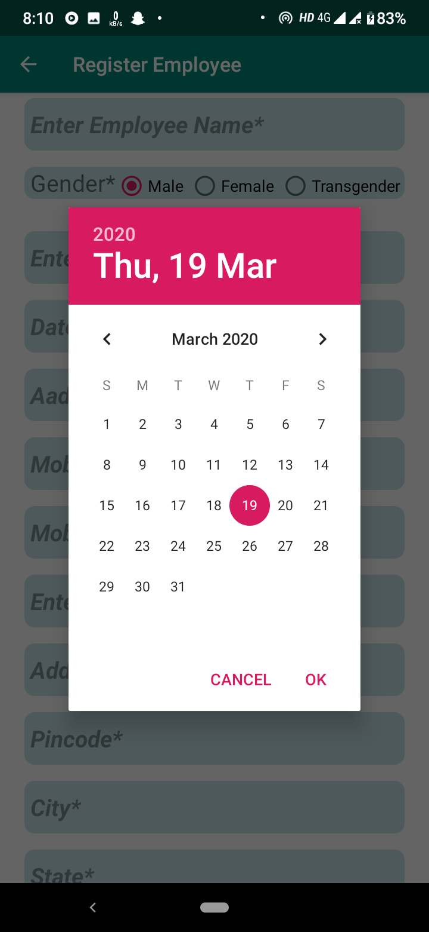
Register Employee

Slide 29
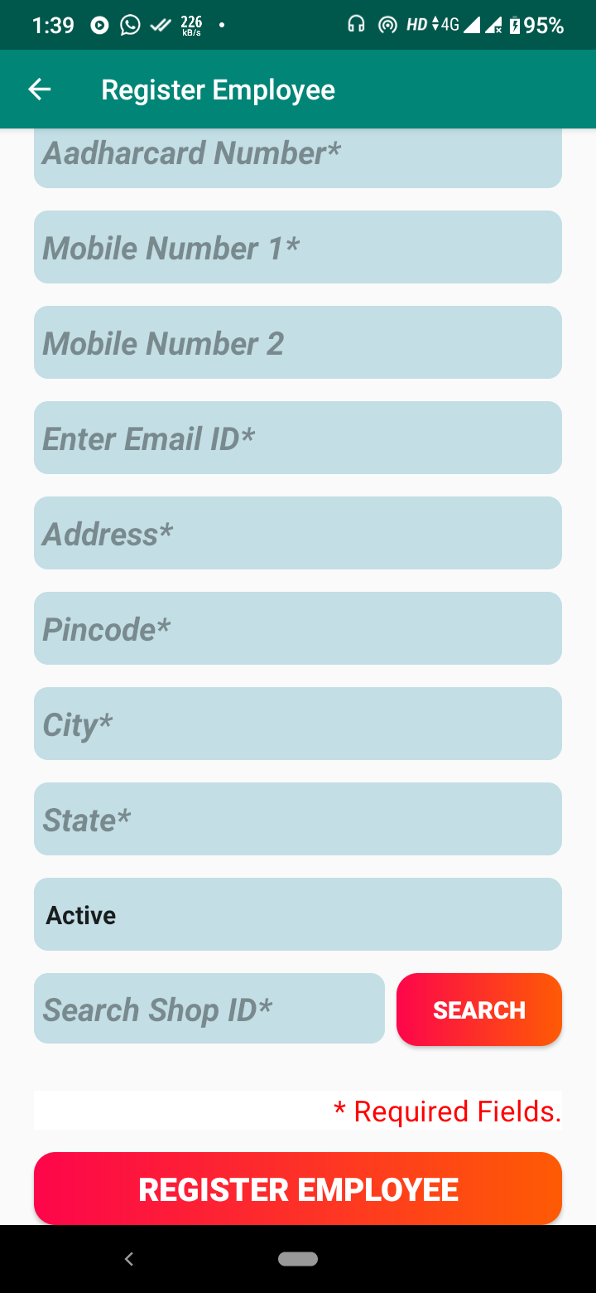
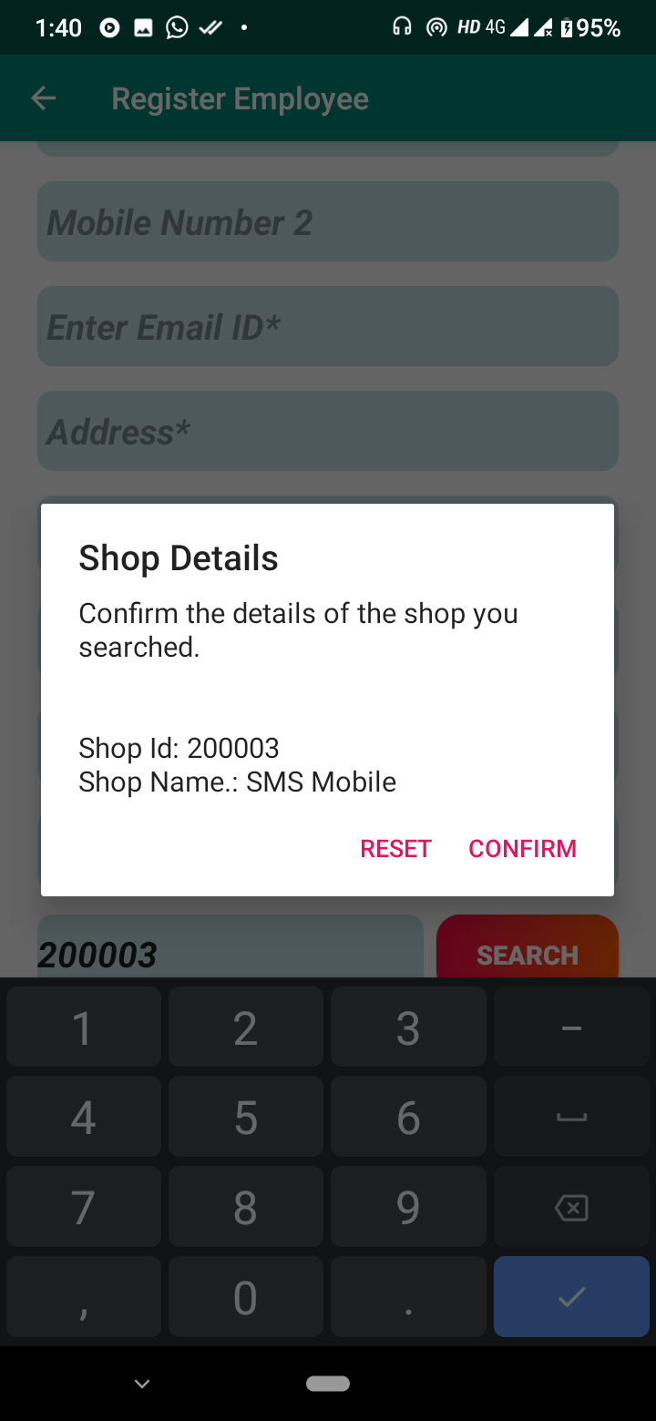
Register Employee

Slide 30
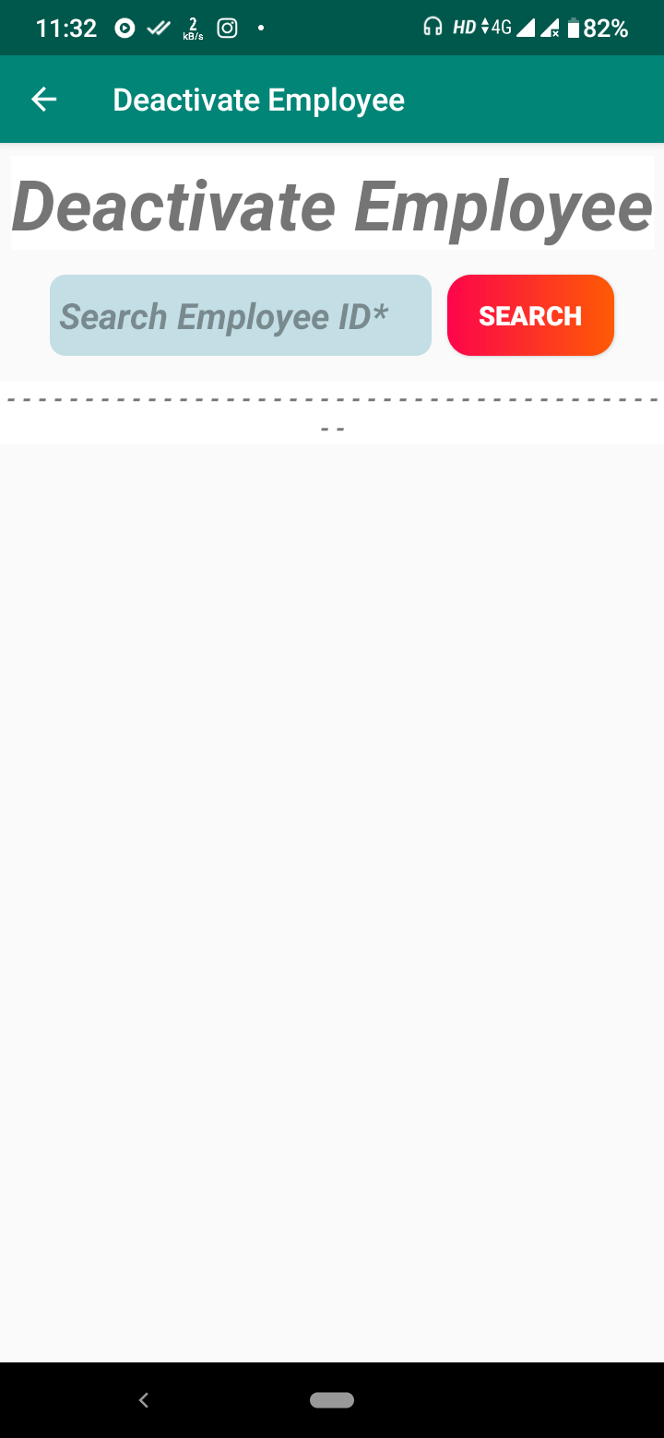
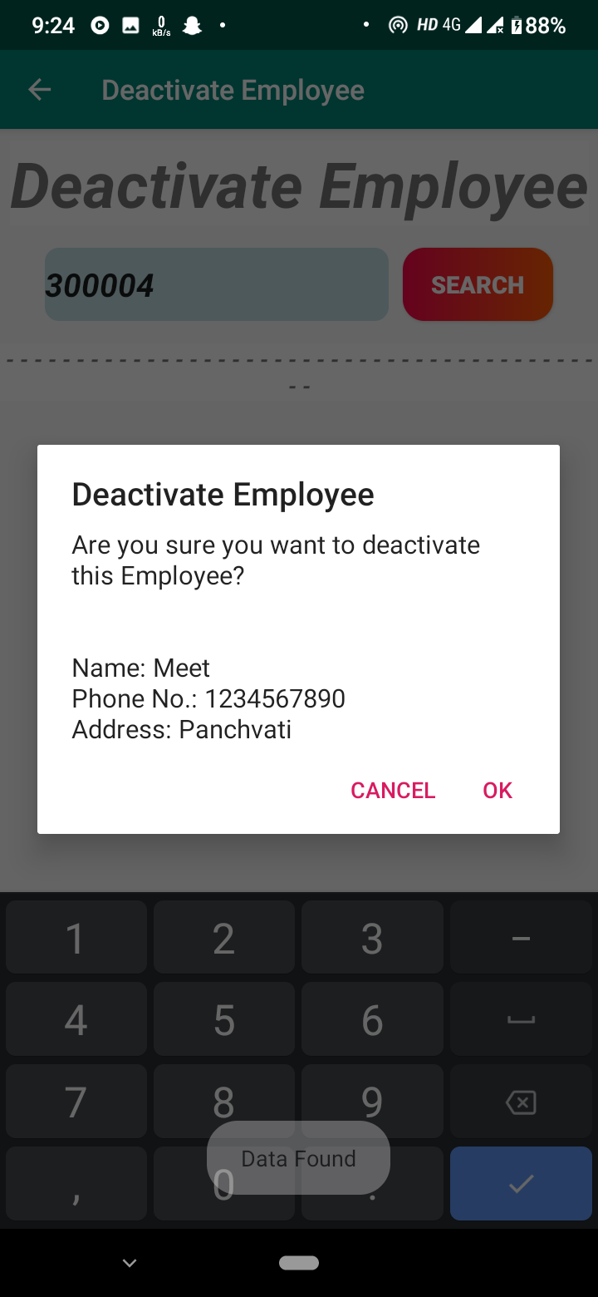
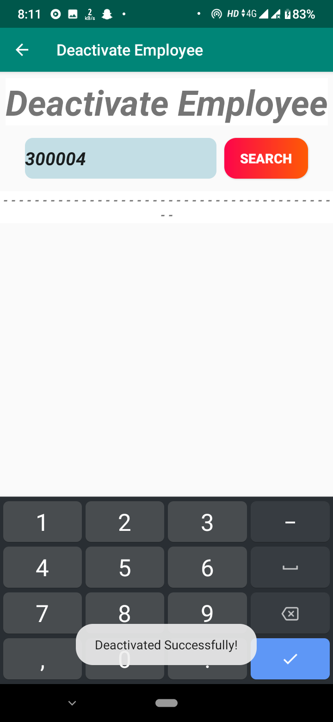
Deactivate Employee

Slide 31
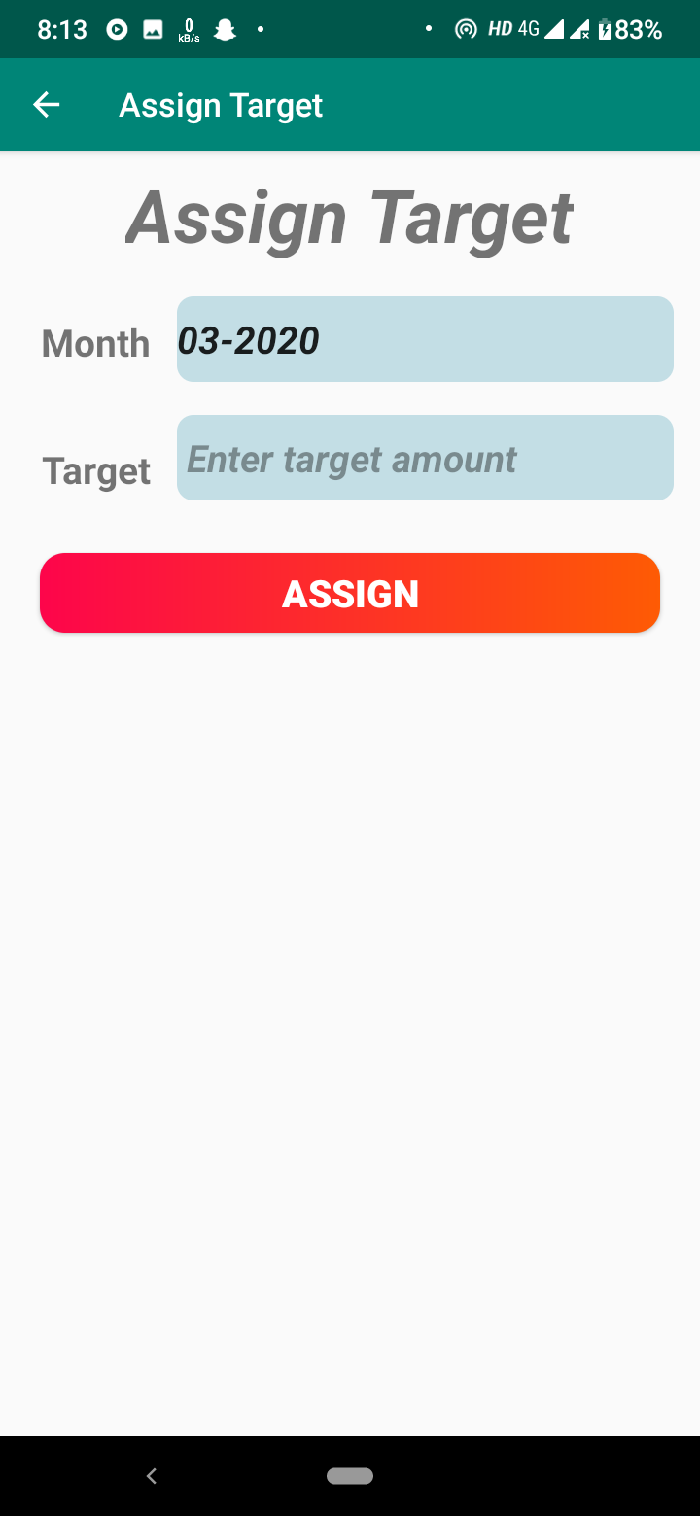
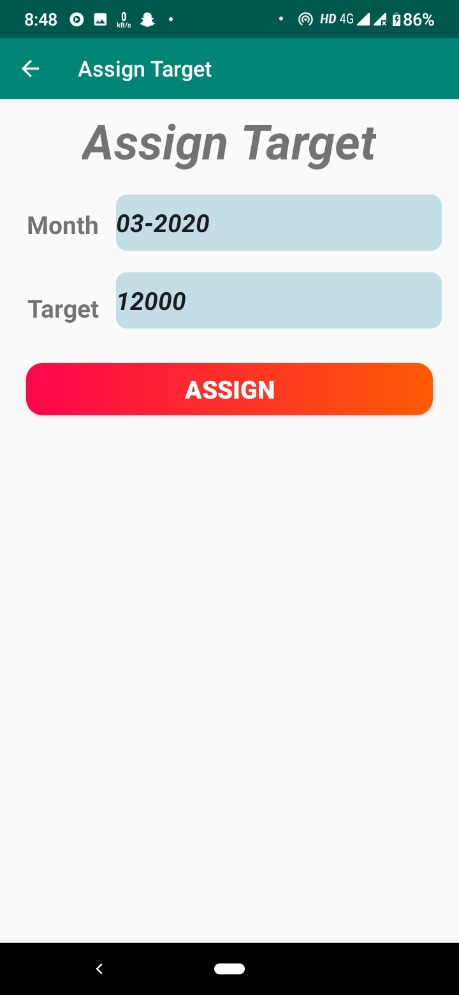
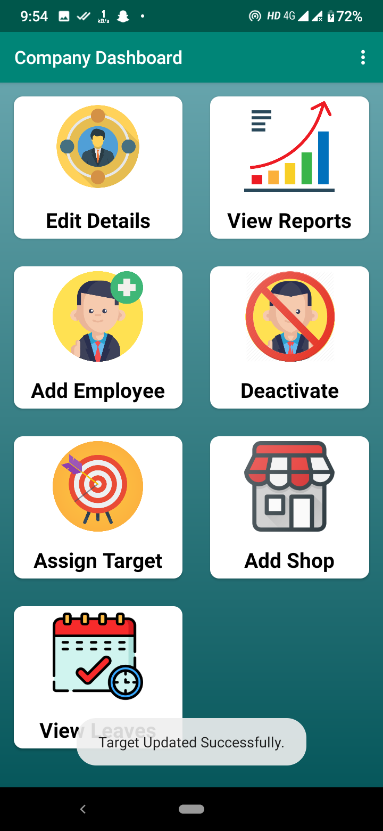
Assign Target

Slide 32
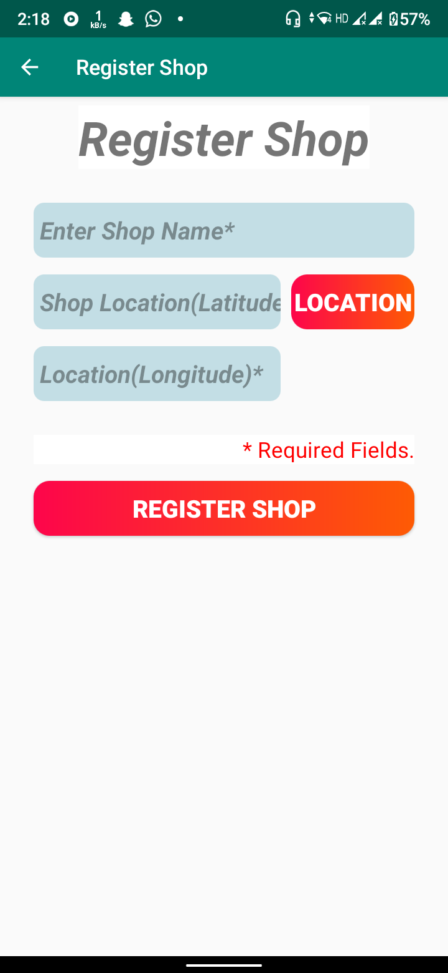
Add Shop

Slide 33
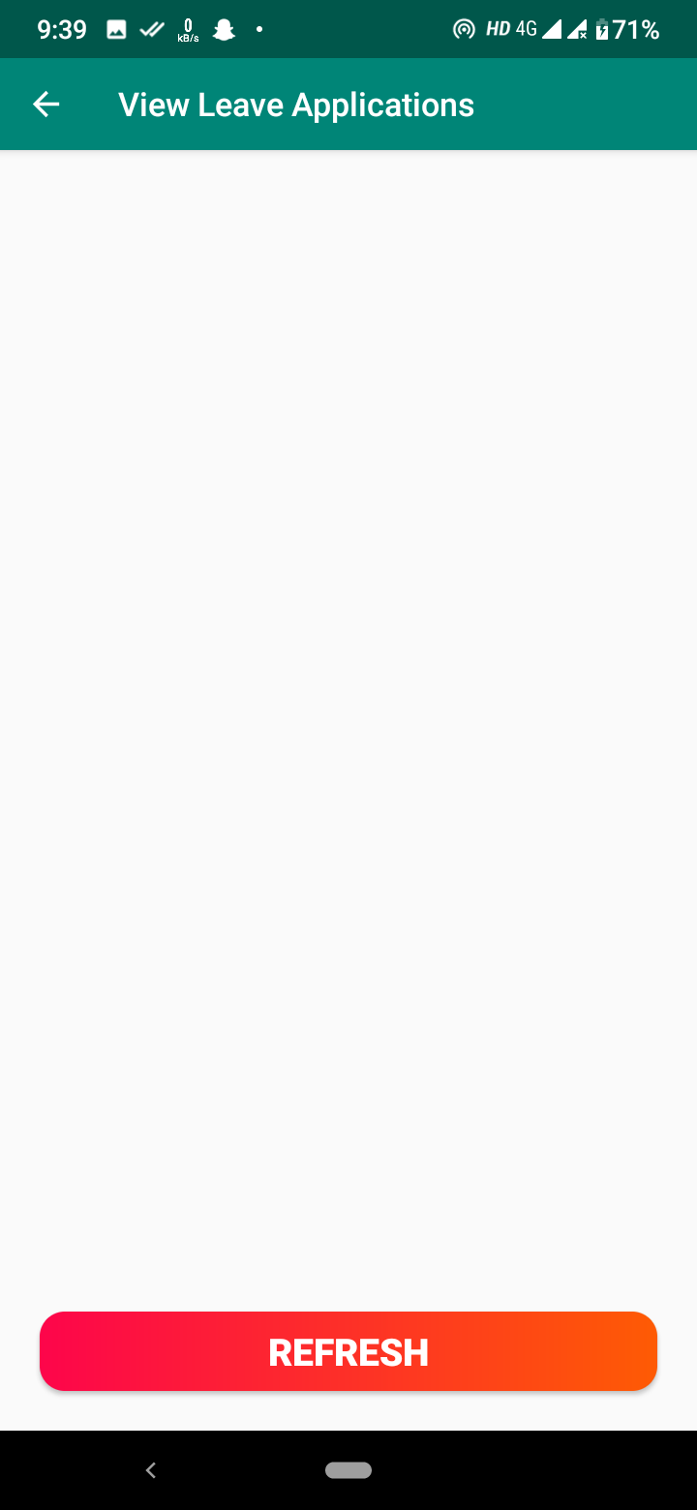
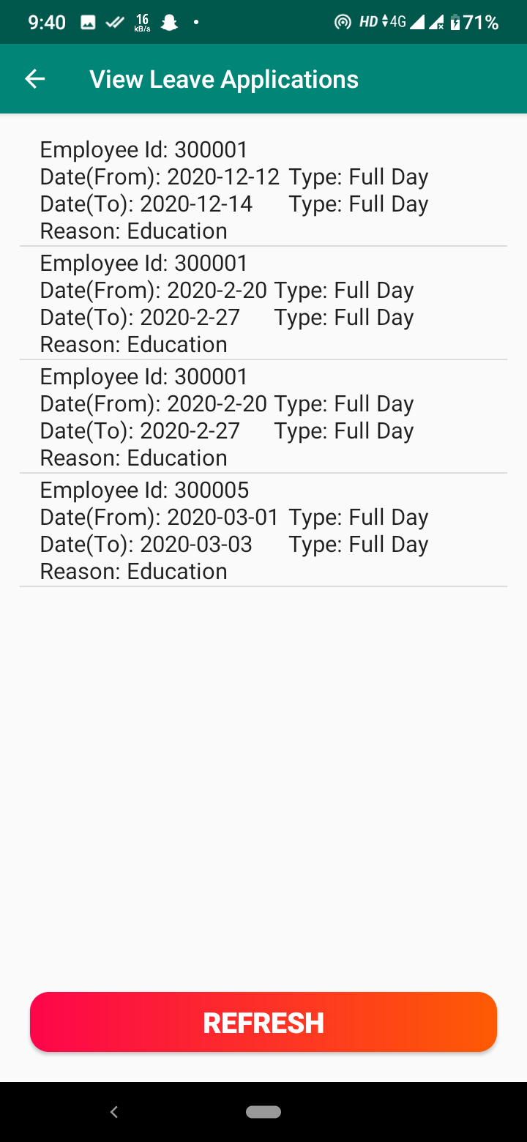
View Leaves

Slide 34
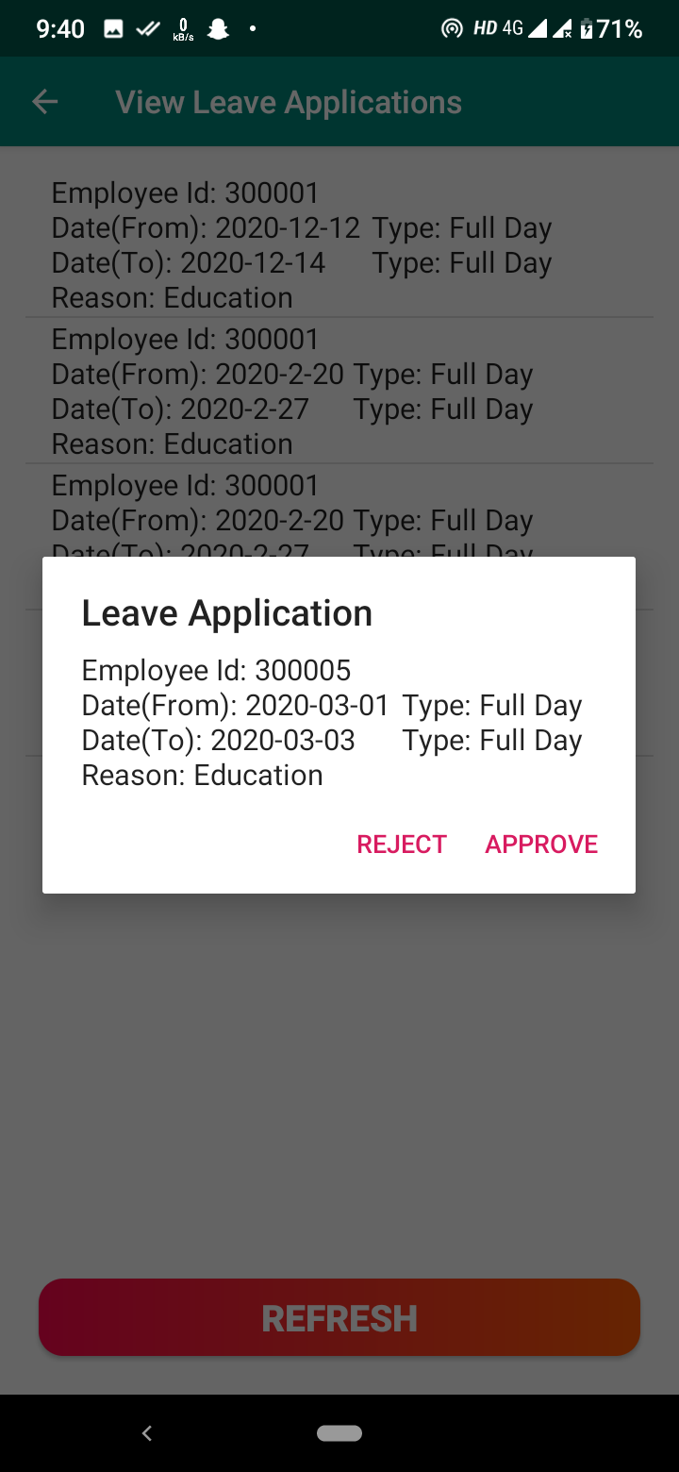
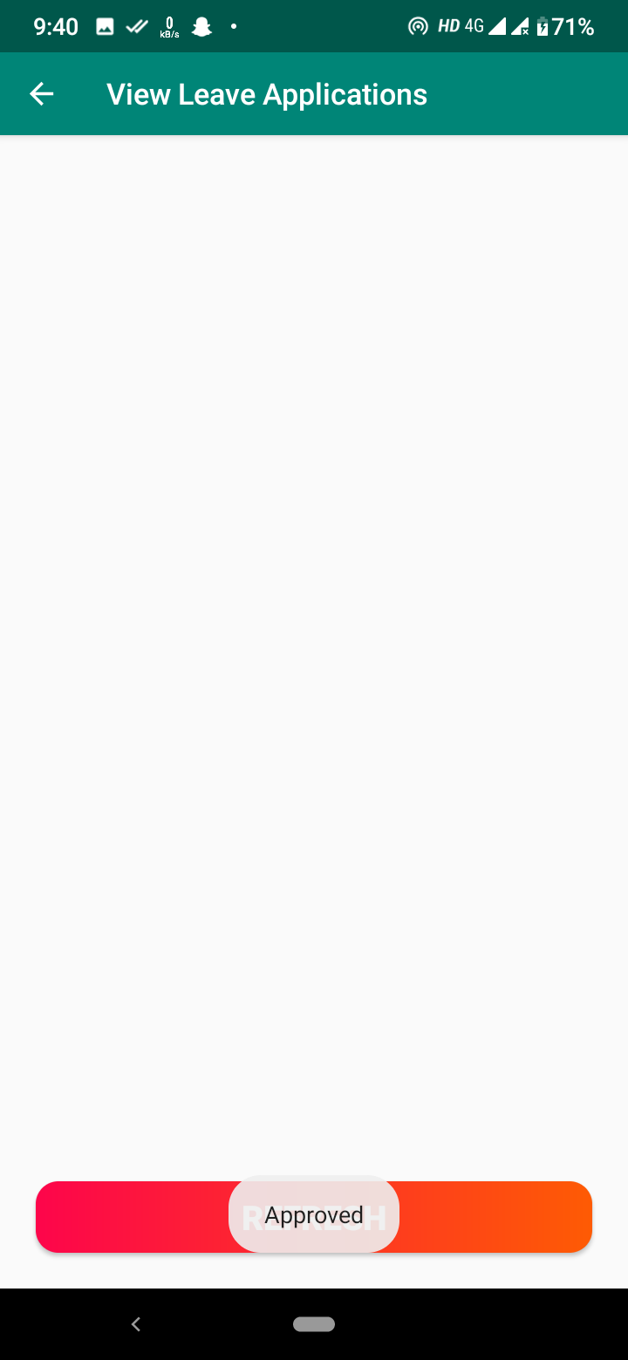
View Leaves

Slide 35
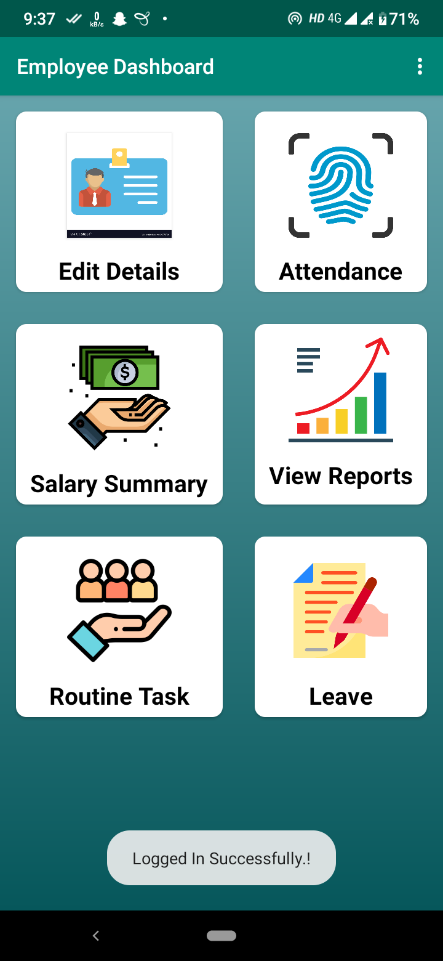
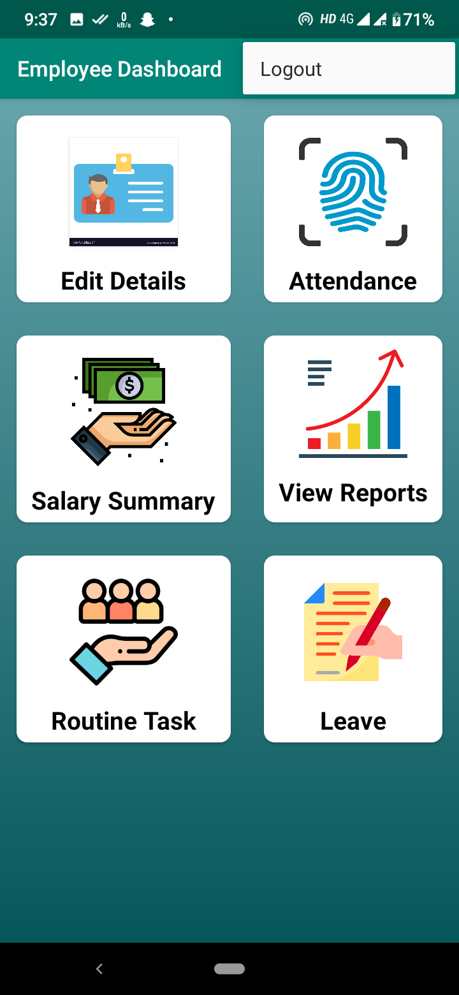
Employee Dashboard

Slide 36
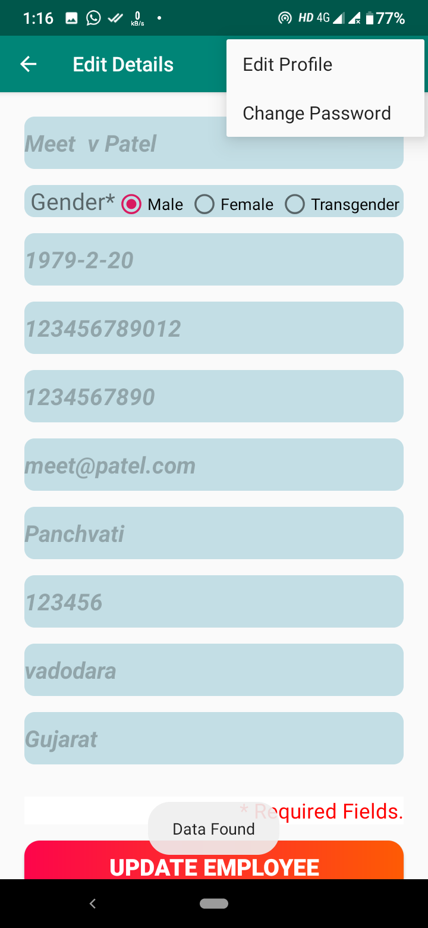
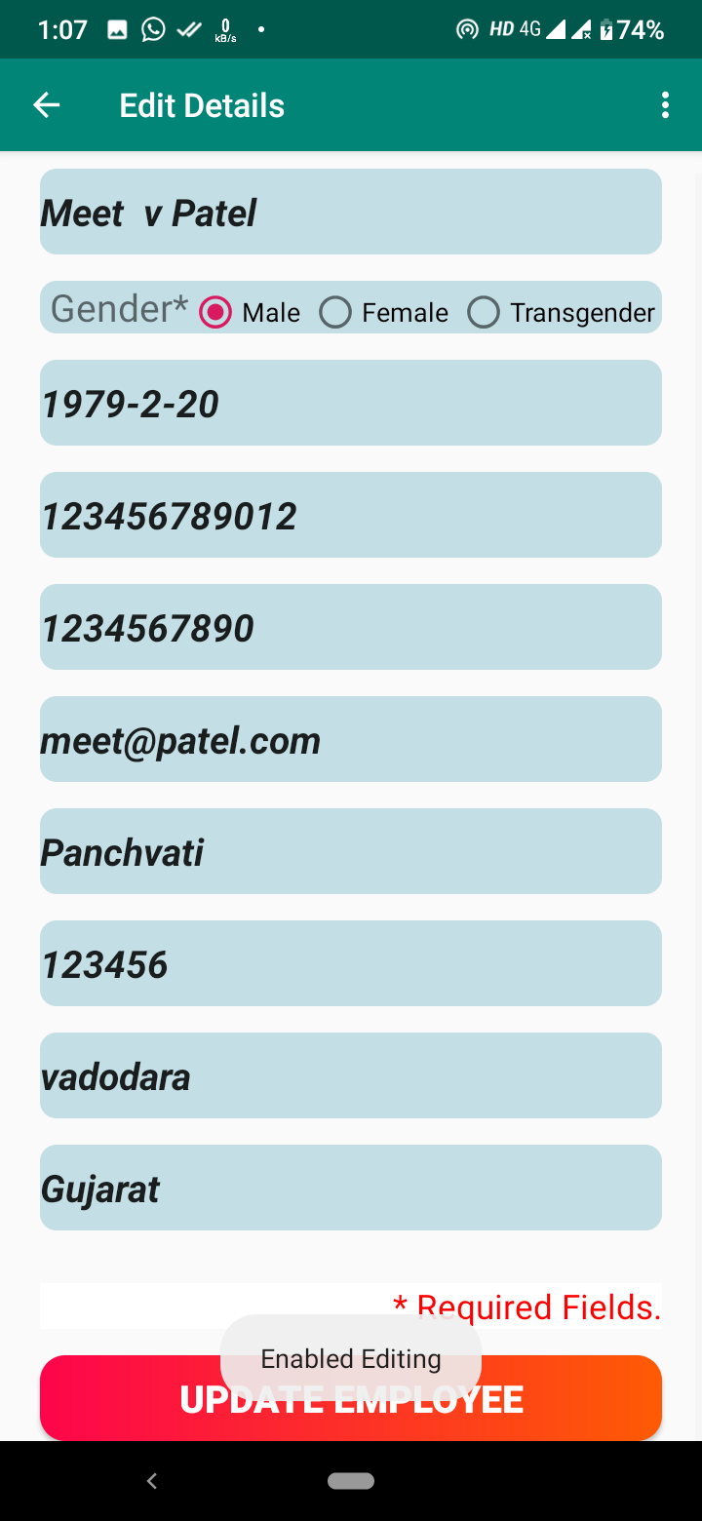
Edit Details

Slide 37
Change Password

Slide 38
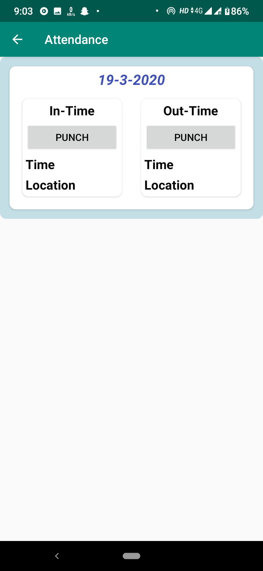
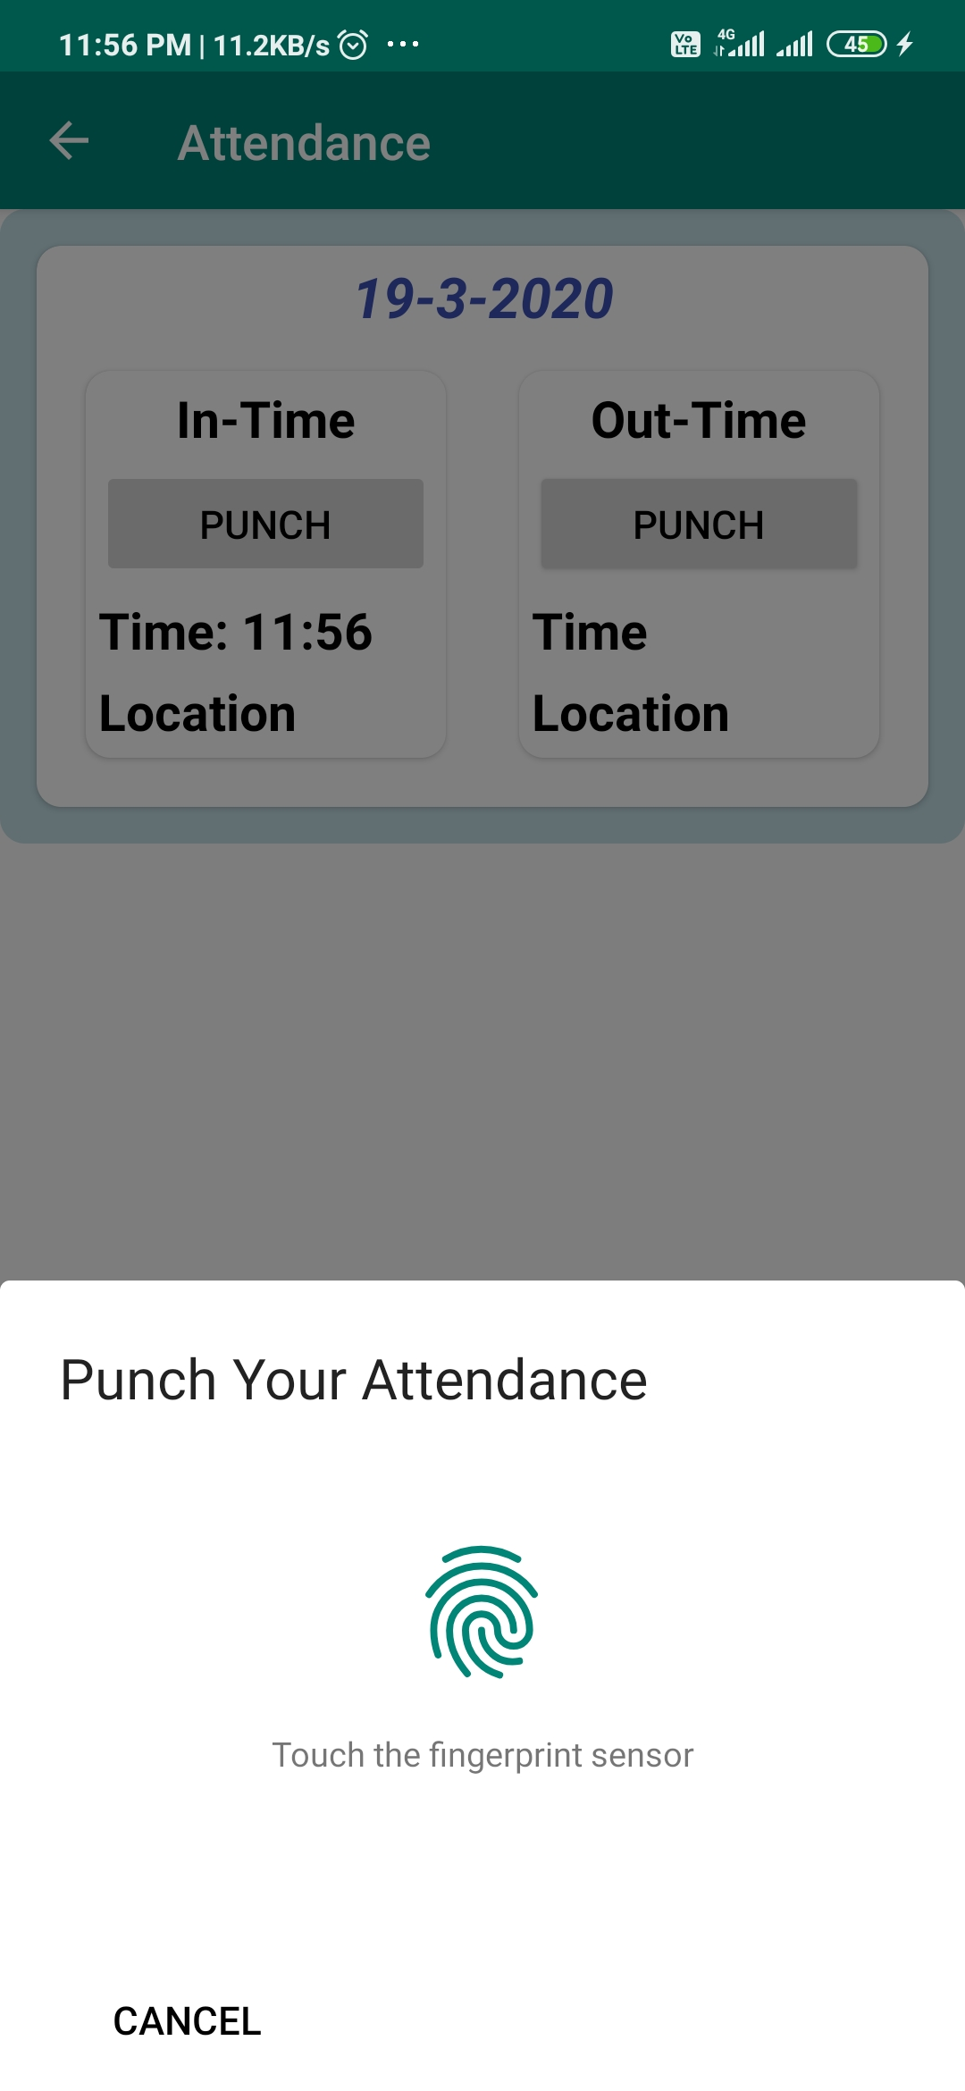
Attendance

Slide 39
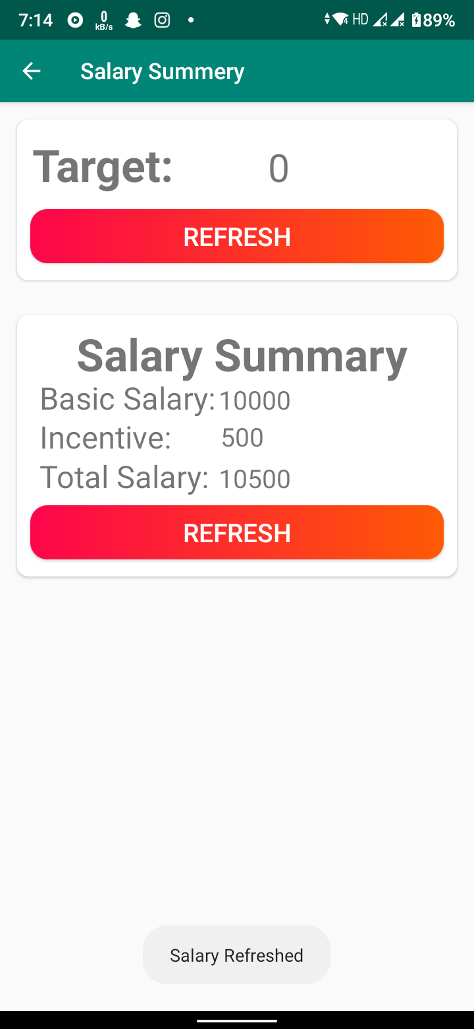
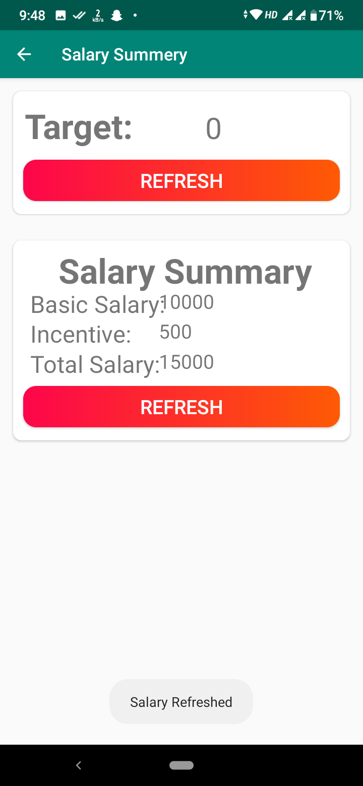
Salary Summary

Slide 40
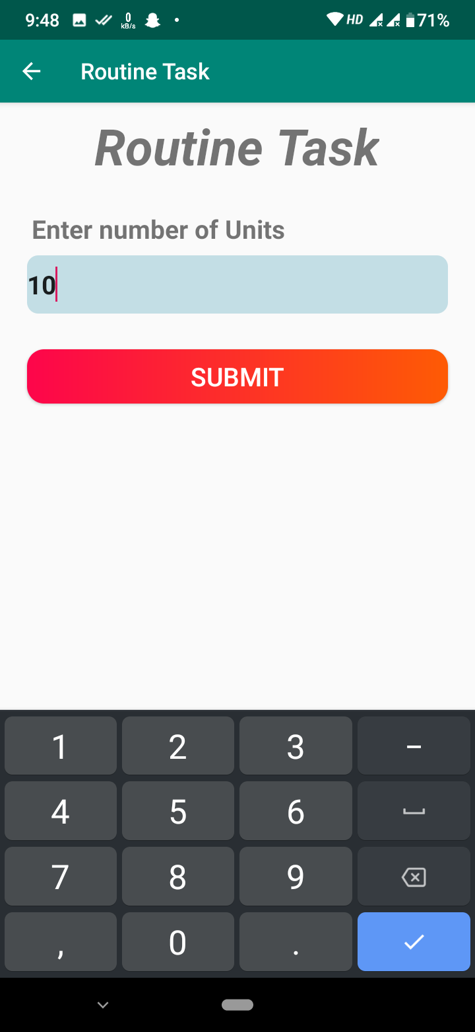
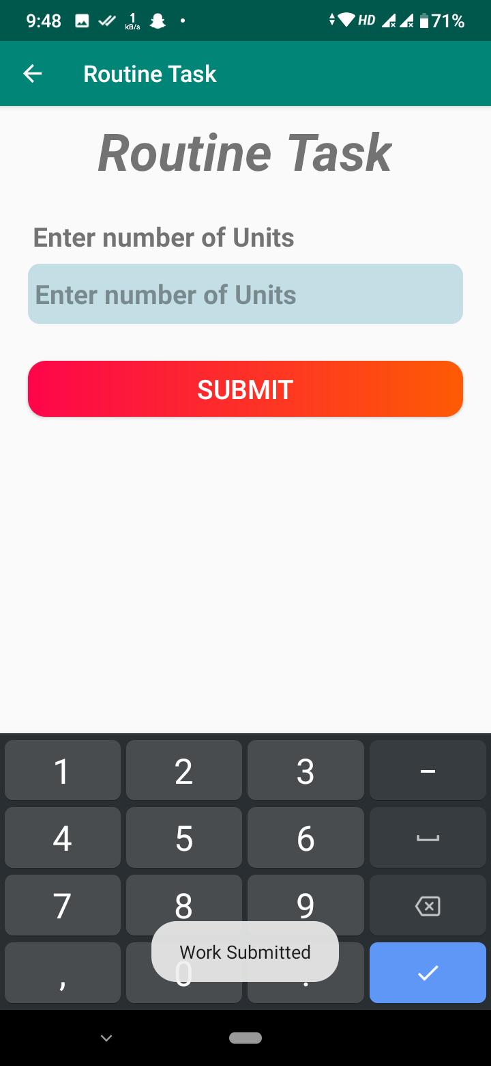
Routine Task

Slide 41
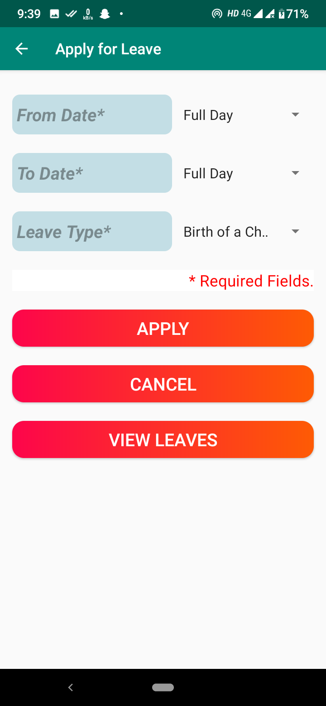
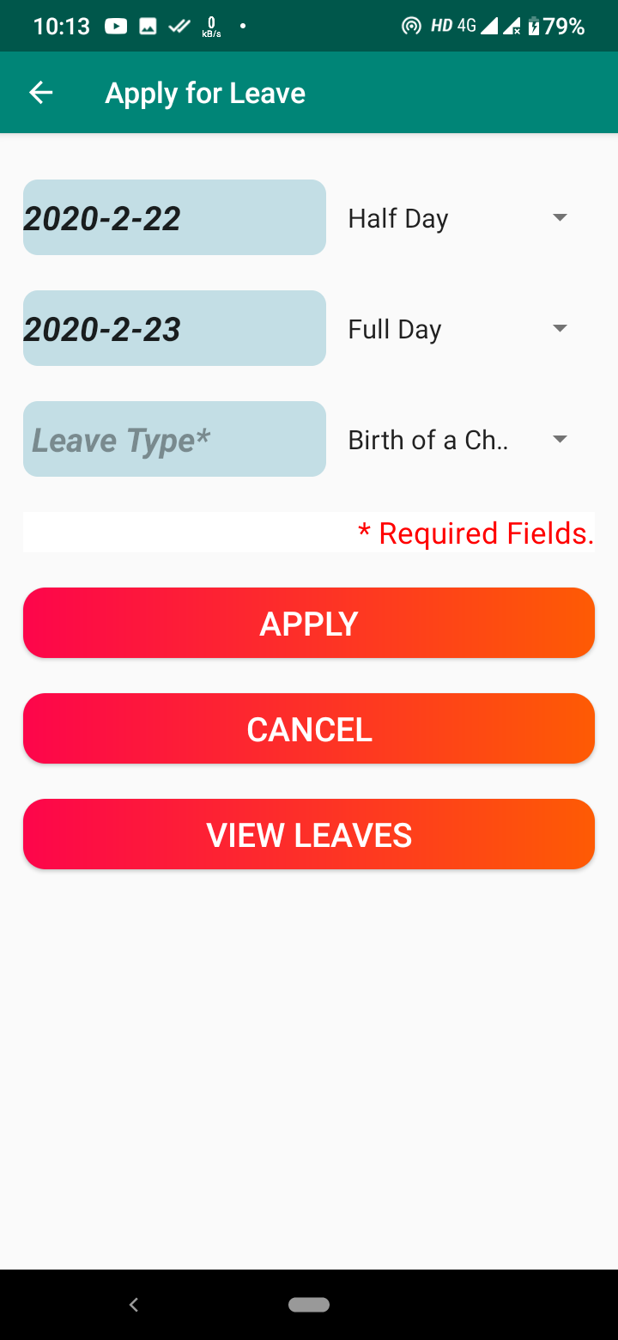

Leave[Apply Leave]

Slide 42

Leave[View Leave]

Slide 43
Test Cases

Slide 44
Test case no | Field | Actual value | Expected outcome | Actual outcome | Remarks
1 | Company_id |  | It should generate error message | It has been generated an error | Successful
2 | Company_password | 1234 | It should generate error message | It has been generated an error | Successful
3 | Company_password | 123456 | Checks the credentials and logged in successfully | Checks the credentials and allow to logged in | Successful
4 | Company_name | A&M Records | Valid name, allows to registration | Allowed to registration | Successful
5 | Company_email | abc@gmail | It should generate error message | It has been generated an error | Successful
6 | Company_email | abc@gmail.com | Valid email, allows to registration | Allowed to enter data | Successful

Slide 45
Test case no | Field | Actual value | Expected outcome | Actual outcome | Remarks
7 | Company_mobile1 | 1231b1@ | It should generate error message | It has been generated an error | Successful
8 | Company_mobile1 | 9976325678 | Valid data, allows to enter data | Allowed to enter data | Successful
9 | Emp_name | abc@1 | It should generate error message | It has been generated an error | Successful
10 | Emp_name | Kartavya | Valid data, allows to enter data | Allowed to enter data | Successful
11 | Emp_dob | 15/02/2022 | It should generate error message | It has been generated an error | Successful
12 | Emp_dob | 11/07/1999 | Valid data, allows to enter data | Allowed to enter data | Successful

Slide 46
Future Enhancement

Slide 47
Multiple employees’ registration at a time
Inter – employee communication
Employee’s load adjustment
Request to resign from company

Slide 48
References

Slide 49
Google play store [For existing system]
[For employee registration form]
https://www.123formbuilder.com/free-form-templates/Company-Registration-Form-2861029/
[For company registration form]
https://www.123formbuilder.com/free-form-templates/New-Employee-Registration-Form-2375089/
[For solution of quires]
https://stackoverflow.com/
[For drawing UML diagrams]
https://app.diagrams.net/
[For logos]
https://www.flaticon.com/

Slide 50
Thank You..

